Slide 1
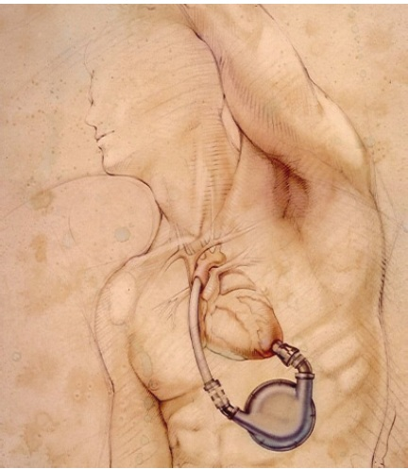
VENTRICULAR ASSIST DEVICES
Dr. Madhusudan Raikar
DM Cardiology Resident
GMC, Kozhikode

Slide 2
Introduction – Problem Statement
Heart failure (HF) incidence and prevalence is increasing at epidemic proportions.
Improved survival in pts. with HF and aging of the population – contributory
In US alone,
Prevalance - 5.8 million ,
Incidence – approx 650,000 new cases annually ,
Over a million annual hospital admissions. ,
> 300,000 deaths/yr ,
Annual cost to Mx - close to $40 billion ,
Approx. 50% have HFrEF ,
Probably 10% have advanced symptoms [NYHA IIIB/IV]

Slide 3
Introduction
Pts. with HF - poor prognosis, low survival and severely diminished QOL
CRT or pharmacological interventions - limited benefit
Medical Mx - ameliorates symptoms and can slow disease progression
Definitive therapy for end stage of HF is cardiac transplantation.
Cardiac Tx - only small no. of pts. because of lack of suitable donor organs

Slide 4
Introduction – Background of LVAD
Lead to development of circulatory support devices - potentially capable of ‘permanent’ mechanical support
First successful cardiac-assist device in humans - implanted by DeBakey at the Texas Heart Institute in 1966
First permanent implant of TAH by William DeVries and Lyle Joyce in 1982 at University of Utah
In 1985, Copeland and colleagues - first successful use of TAH for BTT
First implantation of a LVAD as a BTT - performed by Phillip Oyer in 1984

Slide 5
Introduction
US-FDA approved
Pneumatically driven Left Ventricular Assist Devices as a BTT in1994.
Self-contained, vented electric devices as BTT in 1998.
LVAD as destination therapy established by Rose et. al – REMATCH trial in 2001
Registries from the International Society for Heart and Lung Transplantation - 9755 LVAD were placed worldwide from 2002-2012

Slide 6
Heart Lung Transplant Guidelines

Slide 7
Interagency Registry For Mechanically Assisted Circulatory Support (INTERMACS)
North American registry established in 2005
collects clinical data of pts. receiving device therapy to treat advanced HF.
Has compiled data from >10,000 LVAD patients
Survival for all patient with CF-LVADs at 1 & 2 yr. is 80% & 70% respectively.
1yr. Survival for DT patient using LVAD is 75%

Slide 8
Intermacs Profile
Critical cardiogenic shock - Crash & Burn
Progressive decline - Sliding on inotropes
Stable on inotropes - Dependent stability
Resting symptoms - Persistent advanced symptoms
Exertion intolerant - Minimal activity intolerant
Exertion limited - Walking wounded
Advanced NYHA III
Currently 80% of LVAD implants used in profile 1-3 pateint.

Slide 10
Terms Used
Bridge to Recovery (BTR) – [US-FDA approved]
Potential Reversible Cause (E.G. AMI, Ac. Myocarditis, Post-cardiotomy Cardiogenic Shock)
Bridge to Bridge (BTB)
Temporary MCS continued as a bridge to long term LVAD
Bridge to transplant (BTT) – [US-FDA approved]
Patient eligible for heart transplant
“Destination” therapy (DT) – [US-FDA approved]
Recovery or transplant is not feasible
Bridge to candidacy (BTC)
When eligibility unclear at implant or with comorbidities (e.g. CRS, PAH)
Bridge to Decision (BTD)
Potential for transplant or recovery unclear

Slide 11
What Are MCS Devices ?
Mechanical pumps designed to assist / replace the function of either left / right / both ventricles
It decreases the workload of the heart while maintaining adequate flow and blood pressure

Slide 12
Guidelines For Initiation Of MCS
No absolute hemodynamic criteria to meet
Timing of initiation – crucial for pt. outcome
Generally accepted guidelines (despite use of OMM) :
Cardiac index < 1.8-2.2 L/min/m²
SBP < 90 mmHg
PCWP > 20 mmHg
RA pressure > 18-20 mmHg
Evidence of poor tissue perfusion (oliguria, mental status change, cool extremities)
General C/I for MCS :
Irreversible renal/hepatic/resp. failure
Sepsis
Significant cognitive deficit

Slide 13
Algorithm For Device Therapy:

Slide 14
Indications For VAD:
1) Chronic Heart Failure :
Criteria for VAD (REMATCH Trial)
LVEF < 25%
Peak VO2 < 14 cc/kg/min
NYHA class IV for 60 days
NYHA class III/IV for 28 days and
IABP support for 14 days or
2 failed attempts to wean I.V. Inotropes
Approx. 80% of LVAD implants for BTT

Slide 15
Increased risk of pre-transplantation mortality & decreased long-term post-transplantation survival for device therapy as BTT – NO PROSPECTIVE DATA
BTT – OMM vs. LVAD – to be individualised
C/I for cardiac transplant (REMATCH Trial)
Age >65 years,
Insulin-dependent diabetes mellitus with end-organ damage,
CKD with a serum creatinine concentration of >2.5 mg/dL,
Comorbidities that portend reduced long-term survival:
malignancy,
history of stroke,
end-stage COPD,
Decompensated CLD.

Slide 16
Heart Transplant Vs. LVAD – Exclusion Criteria

Slide 17
2) Acute Refractory Cardiogenic Shock
Acute Fulminant Myocarditis
AMI With Cardiogenic Shock
PPCM
TTCM
Post Cardiac Sx
Unable to maintain an adequate CO
Failure to wean from CPB

Slide 18
3) Bridge to Recovery :
Therapeutic strategy in small subset
Principle :
mechanical unloading with LVAD - reverse remodeling
reduction in chamber size and
improvement in end-diastolic pressure-volume relationship
Retrospective review – difficulty in explantation of device (5/111 Columbia University)
Briks and colleagues – protocol for BTR

Slide 19
Classification Of VAD :
Based On Pumping Mechanism :
Pulsatile
Continuous Flow
Axial
Centrifugal
Mixed
Based On Location Of Pumping Chamber :
Intracorporeal
Extracorporeal

Slide 20
Based On Ventricle(s) Supported :
Left Ventricle (Left Ventricular Assist Device),
Right Ventricle (Right Ventricular Assist Device) ,
Both Ventricles (Bi Ventricular Assist Device)
Based On Duration Of Support :
Short Term (days to weeks)
Long Term (months to years)

Slide 21
Pre-op Assessment
CAG – to assess RV and Septal blood flow
RV function assessment :
ECHO
Severity of TR
RV size
RVEF
TAPSE
Right Heart Catheterization (RA pressure, PVR , RVSWI)

Slide 22
Predictors of RV failure (post LVAD)
RA Pressure > 15mmHg
RAP / PCWP Ratio > 0.6
mPAP < 35 mmHg
RVSWI < 450 ml-mmHg/m²
TPG > 20 mm Hg
PVR > 8 WU

Slide 23
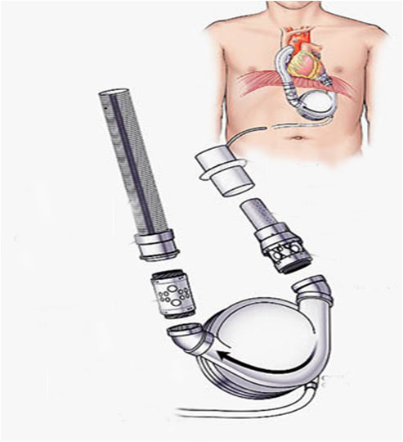
Components Of A VAD
Sewing ring with cuff
Outflow Graft
Inflow Cannula
Connector
Inflow Valved Conduit
Outflow Valved Conduit
Driveline

Slide 24
Components Of A VAD
Electromechanical Pumps - placed in parallel with the native patient’s circulation
Inflow cannula - decompresses the ventricular cavity
In LVAD: originates in LA or LV
In RVAD: originates in RA or RV
In BVAD: originates in both Atriums &/or Ventricles

Slide 25
Components Of A VAD
Pump: Provides propulsion to the blood
Flow can be:
Pulsatile
pneumatically or electromechanically driven
Non pulsatile / Continuous
Axial / Cetrifugal / Mixed
Pump is implanted sub-diaphragmatically to:
Preperitoneal position
Intra-abdominal position or
Para-corporeal position outside the body

Slide 26
Components Of A VAD
Outflow cannula returns blood to either
Ascending aorta (In LVAD) or
Main pulmonary artery (In RVAD)
Controller: Operates pump by receiving and processing information from it.
Percutaneous driveline:
containing the control & power wires, is tunneled through skin of abdominal wall
connects device to external portable driver consisting of electronic or pneumatic controller & power supply that may be worn around waist

Slide 27
Schematic of LVAD

Slide 28
Centrifugal Flow Pump

Slide 29
Axial Flow Pump

Slide 30
Physiology Of CF-LVAD
Flow across pump depends on :
Pump speed – directly proportional
Afterload across LVAD (Head Pressure) – inversely proportional
Axial vs. Centrifugal Pumps :
 | Axial | Cetrifugal
relationship between flow and head pressure | steep and inverse linear | flatter and more susceptible to head pressure changes
Dependent on | Preload | Both preload and afterload
Flow range | 3-7 L/min | 0-10 L/min

Slide 32
These hydrodynamic characteristics of centrifugal pumps translate into:
More pulsatile waveform;
More accurate flow estimation;
Lower risk of suction events (e.g, In setting of dehydration, arrhythmias, or right ventricular failure);
More dependency of device flow on loading conditions

Slide 33
Pulsatility Of Device
Assessed by PUMP INDEX (PI)
PI = [max flow – min flow] / avg flow
Low PI suggests
Hypovolemia
Pump Obstruction
Low arterial pulsatility
cause for several serious adverse effects of CF-LVADs
LVAD speed modulation
Used for antithrombotic cycling to prevent pump thrombosis
Precludes formation of zones of recirculation and stasis within the device

Slide 34
Pump Speed Modulation (I.E., Intermittent Lower-speed Pump Operation)
Generate More Pulsatility
Intermittent Aortic Valve Opening
Advantages :
Generates Intrinsic Pulsatile Flow From LVAD Itself;
And/Or
Allows Native LV To Periodically Create Pulsatile Flow (Conditions Of Increased Ventricular Loading)

Slide 35
2 types :
Synchronous – dependent of native heart rate
Asynchronous – independent of native heart rate
Counterpulsation - maximizes LV unloading
best resting conditions for failing heart.
Copulsation
enhances Pulse Pressure
decreases the likelihood of aortic valve opening
Asynchronous – physiological benefits of intermittent copulse-counterpulse support

Slide 38
Types Of Ventricular Assist Devices
SHORT TERM DEVICES :
Percutaneous :
Include devices that are inserted through femoral artery & advanced to left heart
Examples :
Impella 2.5 pump –
Impeller-driven, axial flow pump, capable of pumping 2.5L/min
TandemHeart :
Low speed centrifugal continuous-flow pump
Drains oxygenated blood through a catheter advanced across the IAS to the LA & pumps it back to one or both femoral arteries

Slide 39
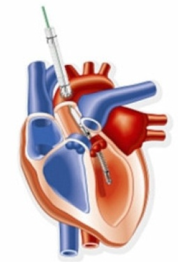
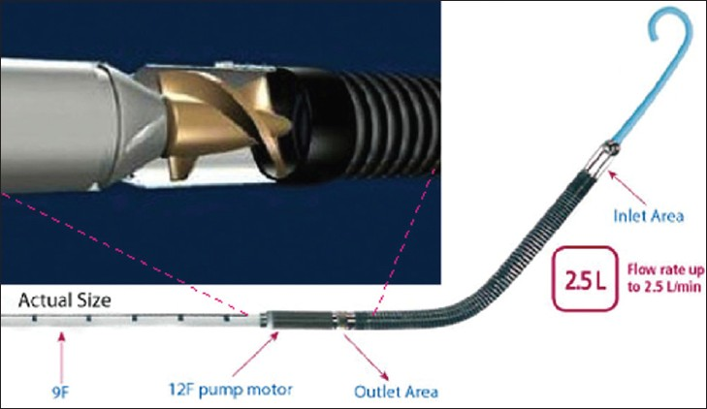
Impella VAD

Slide 40
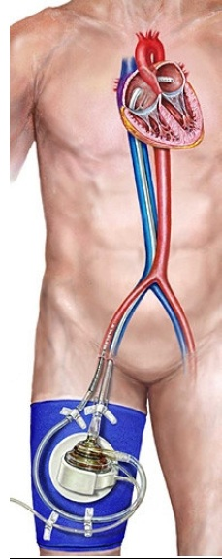
TandemHeart VAD

Slide 41
Extracorporeal :
Bio – Medicus
Abiomed – BVS
Thoratec CetriMag Blood Pump
Advantages :
Widely available
Relatively inexpensive
Simple and quick implantation
May be used as
RVAD
LVAD
Part of ECMO circuit
Disadvantages :
Requires systemic anticoagulation
Requires ICU monitoring
Limited mobility

Slide 42
Types of Ventricular Assist Devices
LONGER TERM ASSIST DEVICES (3 GENERATIONS) :
First Generation Or Pulsatile Flow Pumps
Second Generation Or Continuous (Axial) Flow Pumps
Third Generation Or Continuous (Centrifugal) Flow Pumps

Slide 43
First Generation Or Pulsatile Flow Pumps
Salient features :
Large size
Preload dependent
Decreased durability
Requires unidirectional valves (biological / mechanical)
Pump placed intra-abdominally or pre-peritoneally in a pocket under rectus abdomini.
Pump capacity - up to 10 L/min
Complicated Control Mechanism

Slide 44
First Generation Or Pulsatile Flow Pumps
Anticoagulation necessary for all devices, (except HeartMate XVE)
Noisy and uncomfortable (percutaneous leads are large, stiff & contain air vent channel)
Increased risk of hematomas and infections as they are large in volume,requiring extensive surgical dissection
Examples :
HeartMate® I
HeartMate XVE (Thoratec Corp., Pleasanton, CA)
Novacor VAD (WorldHeart Inc., Oakland, California, USA

Slide 45
Types of Ventricular Assist Devices
Heartmate I
Made of titanium with a polyurethane diaphragm & has a pusher-plate actuator
Cannula is placed in the apex of the left ventricle
Blood flows through a Dacron conduit to the pump,
Returns into a Dacron outflow graft through another porcine valve to the ascending aorta
Resist thrombogenesis d/t titanium microspheres and a fibrillar textured inner surface
Can pump 4–10 l/min

Slide 46
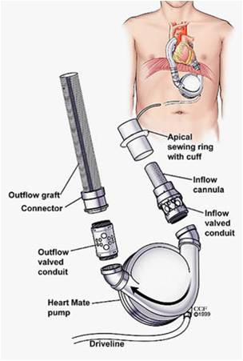
Types of Ventricular Assist Devices
Heartmate I VAD

Slide 47
Types of Ventricular Assist Devices
HeartmateXVE (Thoratec Corp)
Has a 65 ml stroke volume pumping chamber and two mechanical valves
Positioned on the anterior abdominal wall with cannulas crossing into the chest wall
Can be used an LVAD, RVAD or BIVAD
Produces a beat rate of 40–110 bpm & a flow rate of 1.3–7.2 l/min
Warfarin (international normalisation ratio = 2.5–3.5) & aspirin anticoagulation required

Slide 48
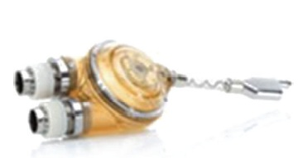
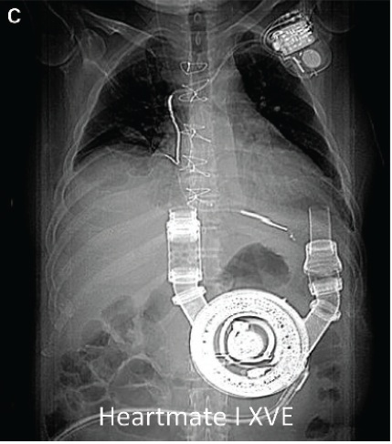
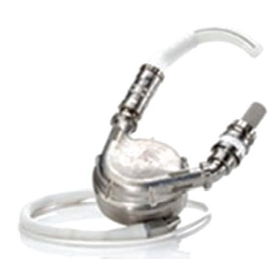
Types of Ventricular Assist Devices
HeartMate I XVE

Slide 49
Types of Ventricular Assist Devices
Novacor VAD
Consists of pump drive unit which is implanted in the left upper quadrant of the abdomen
Incorporates a dual pusher plate 70 ml stroke volume
Contains sac-type blood pump with a smooth blood-contacting surface, coupled to a pulsed-solenoid energy converter drive
Inflow cannule is inserted through the diaphragm into the left ventricular (LV) apex
Outflow graft anastomosed to the ascending aorta

Slide 50
Second/Third Generation Or Continuous Flow Pumps
Salient Features :
Smaller size
More durable
Similar pump capacity (upto 10 L/min)
Dependent on both preload and afterload
Fewer moving parts (only the rotor)
Smaller blood contacting surface (less thrombosis)
Drivelines are less thick and more flexible
Decreased energy requirements (battery lasts longer)
Quieter function

Slide 51
Second Generation Or Continuous Flow Pumps
Examples:
HeartMate 2 VAD (Thoratec Inc.)
Jarvik 2000 (Jarvik Heart Inc., New York)
Berlin Heart Incor (Berlin Heart AG)
Micromed Debakey VAD

Slide 53
Types of Ventricular Assist Devices
HeartMate II
Continuous-flow axial blood pump with internal rotor with helical blades that curve around central shaft
Twisted shape of outlet stator vanes converts radial velocity of blood flow to axial direction
Can pump up to 10 l/min
Axial flow design & absence of blood sac eliminate need for venting

Slide 54
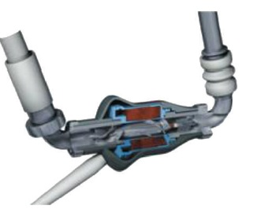
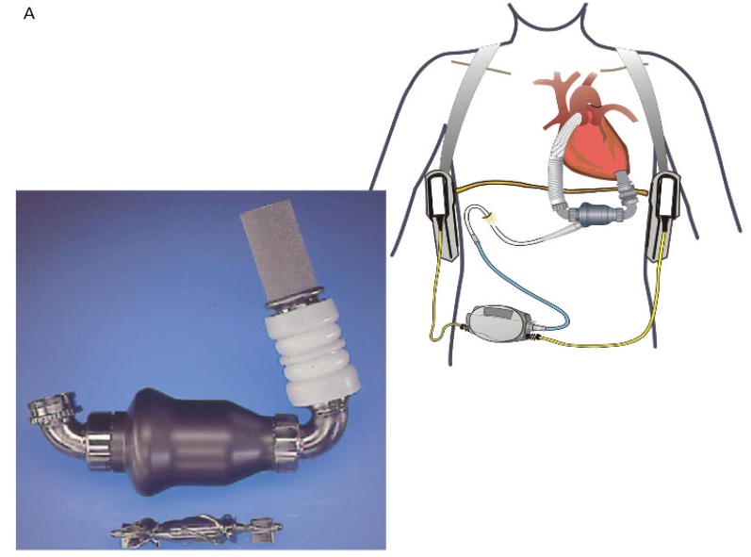
Types of Ventricular Assist Devices
Heartmate II axial flow second-generation ventricular assist device

Slide 55
Types of Ventricular Assist Devices
Jarvik 2000
Axial flow, continuous-flow pump having intraventricular position with whole pump sitting within the LV cavity
Impeller is only moving componant located in centre of the titanium housing
Blood flow is directed through outlet graft by stator blades located near pump outlet & returns to either ascending or descending aorta
Can pump 8 l/min, serious infections rare

Slide 56
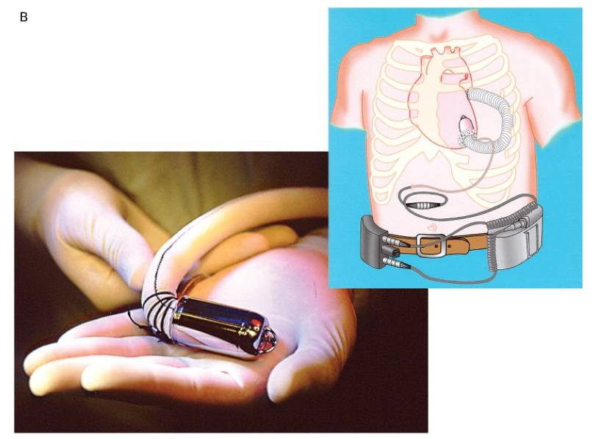
Types of Ventricular Assist Devices
Jarvik 2000 second-generation axial flow pump

Slide 57
Types of Ventricular Assist Devices
Berlin Heart Incor
An axial flow pump
As blood passes into the Incor, it first passes the inducer that guides laminar flow onto actual impellar, which is suspended by a magnetic bearing
Stationary diffuser behind rotor has specially aligned blades which reduce the rotational effect of blood flow
Also creats additional pressure to assist transport of blood in the outflow cannula to the aorta

Slide 58
Types of Ventricular Assist Devices
MicroMed-De-Bakey VAD
Axial flow rotary pump
Consists of :
Elbow-shaped inflow cannula that inserts into LV apex
Pump housing unit which houses the impeller
Dacron outflow conduit graft
Ultrasonic flow probe that encircles the outflow graft

Slide 59
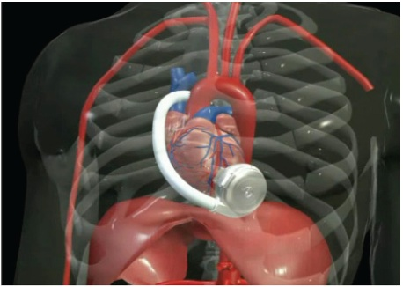
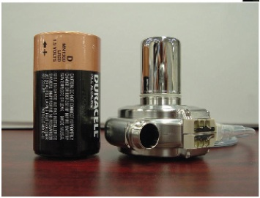
Third Generation Ventricular Assist Device
Examples :
VentrAssist VAD (Ventracor Ltd, Chatswood, New SouthWales, Australia)
DuraHeart (Terumo, Somerset, New Jersey, USA)

Slide 60
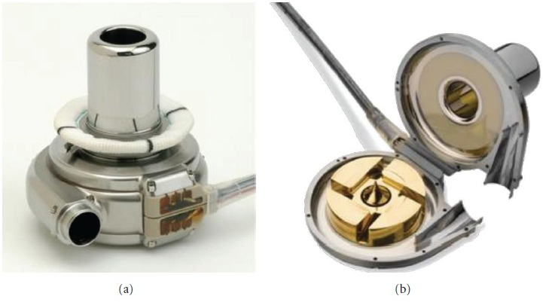
Types of Ventricular Assist Devices
External (a) and internal (b) view of third-generation continuous-flow rotary left ventricular assist device

Slide 61
Total Artificial Heart
Complete support for severe BV failure
In situations where leaving native heart in place detrimental :
Cardiac tumours
Aortic insufficiency or prosthesis
Arrhythmias
LV thrombus
Acquired VSD
Currently approved
for BV support as BTT
Humanitarian use device (HUD) designation for DT

Slide 62
Adequate intrathoracic space required (fitting criteria)
BSA > 1.7 m²
Cardio-Thoracic Ratio > 0.5
AP distance of Thorax > 10 cm
LVDD > 66mm
Combined ventricular volume > 1500 ml
Strict anticoagulation with warfarin, aspirin and pentoxifylline
Examples :
CardioWest TAH (SynCardia systems, Tucson, Ariz)
AbioCor TAH (Abiomed Cardiovascular Inc, Danvers, Mass)

Slide 63
Contraindications For VAD Therapy
Active systemic infection or major chronic risk for infection
High surgical risk for successful implantation
Recent or evolving stroke
Neurological deficits
Fixed pulmonary or portal hypertension

Slide 64
Contraindications For VAD Therapy
Intolerance to anticoagulation
Morbid obesity (BMI>45 kg/m2)
RV dysfunction
CKD with serum creatinine level >3.0 mg/dL
Restrictive CM
Significant underlying psychiatric illness or lack of social support

Slide 65
Complications Of VAD
General :
Bleeding Risk
Acquired von Willebrand’s syndrome
Small bowel AV malformations
Thrombosis – increases stroke risk
Hemolysis – VAD destroys blood cells
Infection
sepsis is leading cause of death in long-term VAD support
Depression/ Adjustment Disorders

Slide 66
Complications Of VAD
Cardiac related :
RV dysfunction / failure
Closed Aortic Valve – blood stasis and clot formation
Aortic Insufficiency
Lack of valve opening
LV decompression
Female Gender
Small Body Size
4. Ventricular Arrhythmias – contact of inflow cannula with endocardium

Slide 67
Complications Of VAD
LVAD related :
1. Pump Thrombosis – rare but catastrophic
Consider in setting of BV dysfunction
Presents as Ac. Pul. Edema with hypotension
Lab E/O hemolysis
Surges in pump power
Decrease in PI
2. Device failure / malfunction (highly variable by device)

Slide 68
3. Increased LVAD Afterload
Outflow graft kinking or obstruction
Assessed by pullback along the graft or contrast CT angio
4. Suckdown
Low preload causes a nonpulsatle VAD to collapse the ventricle
Leads to acute pump thrombosis

Slide 69
Post-op Surveillance
Clinical assessment
ECHO
Right Heart Catheterization (if required)
Adjustment of vasodilators, diuretics and pump parameters.

Slide 70
Prognosis Of LVAD

Slide 71
Landmark Trials

Slide 72
THANK YOU

